Slide 1

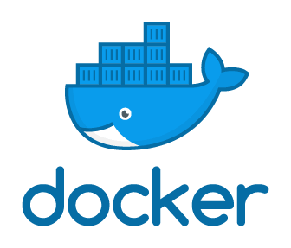
Introduction To Docker
A little bit of background with plenty of hands-on
Notes:
This presentation will cover Docker fundamentals with the intent to get you into some real-world, hands-on practice as quickly as possible. I want you understand Docker and be able to functionally use Docker with the information in the presentation. If you don’t know a thing about Docker, this is a great place to start. If you know some Docker and want a review, you are in the right place. If you have extensive Docker experience and want to learn more, you won’t find what you’re looking for here although I would love to get your feedback on the material and understand how I can make it better. Let’s get to it!

Slide 2
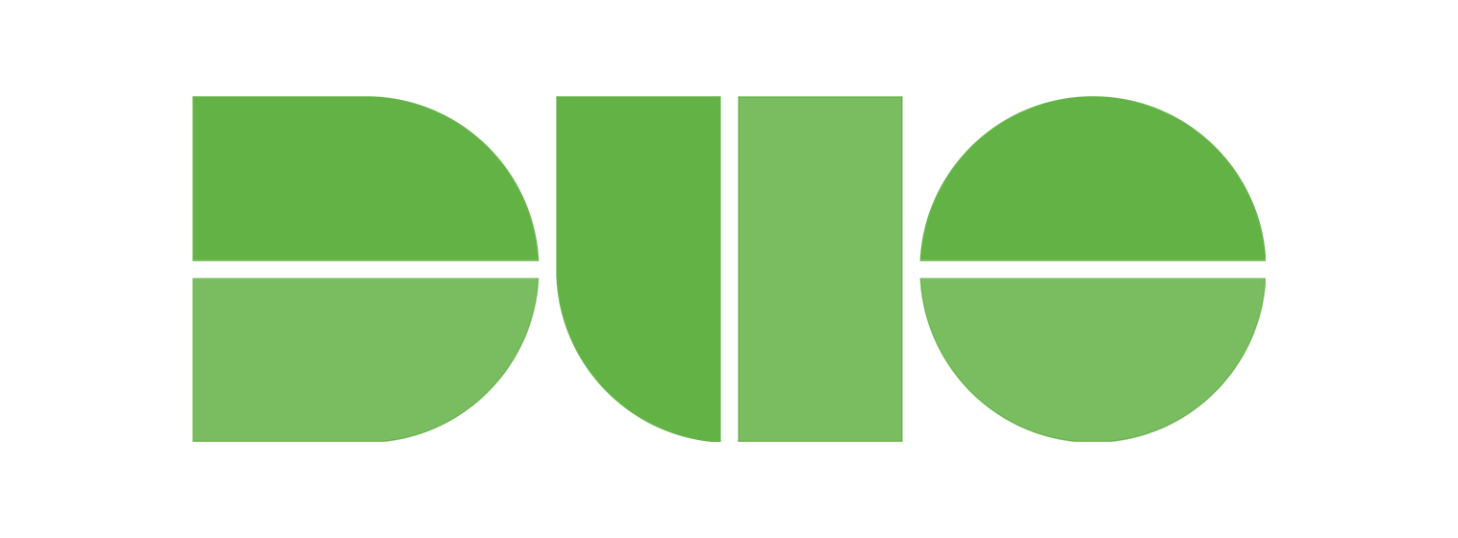
If you want hands-on practice…
Create a Docker Hub Account
https://hub.docker.com/signup
Download and install Docker Desktop
https://www.docker.com/products/docker-desktop
Connect to the ATC VPN
https://atc-support.apps.wwtatc.com/vpn_access
Download this repo from WWT’s internal GitHub
https://github.wwt.com/hullt/docker-foundations
Install a code editor
https://code.visualstudio.com/Download
Wait a few minutes while we get through a Docker overview
Notes:
Let’s cover the prerequisites for the hands-on activities:
First, you should have a Docker Hub Account. Technically, this isn’t required for what we will cover but having a Docker Hub account is a lot like having a GitHub account; it’s something you are likely to use eventually.
Once you have a Docker Hub Account, download and install Docker Desktop for your computer.
This presentation with all of the presenter notes, all of the files you need for the hands-on tasks, a Docker commands reference, and a README file that explains how to use all of this stuff are on an internal GitHub repo.
You need to connect to the ATC VPN to get to the repo so, if you aren’t already enrolled in the Duo authentication system, follow the link on the ATC Support page to Service Now then click on Self-Service Portal.
From the Self-Service Portal navigate to Service Catalog>ATC Requests and click on Request Technical Support.
Request ATC VPN access in the form and wait for the Duo enrollment email.
After you connect to the ATC VPN you can download this repo and have access to everything you need.
Don’t worry if you aren’t familiar with using GitHub; the README file will explain how to download the repo
Like having a Docker Hub account, having a code editor isn’t required but it will sure make things easier on you than using Notepad.
The screenshots and recordings in this presentation use Visual Studio Code and it seems to be the first choice for the WWT DevNet Study Group.
It’s free, easy to use, and has tons of integrations, including several for Docker, which will help you get started quickly.
That’s a long list of prerequisites although you are very likely to reuse all of these tools in your DevNet studies and, ideally, to make your job easier.
Now we can go through some Docker fundamentals and get to doing actual stuff with Docker

Slide 3
Part I
Docker Background
Notes:
I learn best when I have my hands on the keyboard so I will make the promise that we will cover just enough of the fundamentals so that you aren’t lost when it’s time for the hands-on exercises, and no more. If you want to dig into the fundamentals more deeply, there are reference links at the end of the presentation which cover every source I used to put all of the slides together. I had to use Docker to really get Docker and my hope is that the combination of the quick background, hands-on exercises, and references work as well for you as they have for me.

Slide 4

Why Does Does Docker Matter?
Helps use fewer resources than virtual machines
Creates portability between different operating systems and clouds
Easy to spin up and spin down, rapidly
Translation – Docker helps organizations move faster, be more agile, and save money
Notes:
Let’s answer the most important question first: why does Docker matter and why should you care? You might be thinking, “isn’t Docker just a different kind of virtualization?” or “I know how to use vSphere, Hyper-V, AWS EC2, or something of the like, what is so special about Docker?”
Put simply, Docker does three things really well:
It improves the scale of conventional virtualization
Makes applications and services highly portable
Turns those applications and services up and down, and scales them vertically and horizontally, in milliseconds; seriously.
The bottom line is every organization wants to be faster, more flexible, and do both of those thing at the lowest possible price. Docker matters, a lot, to every organization we work with so we need to understand Docker in order to be valuable and relevant.
What that really means to us is…don’t be a CONE! Learn something new, enjoy the process, and get some tangible value as a result.

Slide 5
What is Docker?
“Docker is a set of platform as a service products that use OS-level virtualization to deliver software in packages called containers. Containers are isolated from one another and bundle their own software, libraries and configuration files; they can communicate with each other through well-defined channels.”
https://en.wikipedia.org/wiki/Docker_%28software%29
Okay…then what in the heck is a container?
Notes:
In the spirit of what has become a WWT DevNet study group tradition, I included a snippet about Docker from Wikipedia. If you are new to Docker, terms like, “OS-level virtualization” and “containers” may not mean a whole lot to you so let’s start with defining what Containers are and work from there.

Slide 6
What is Container?
“OS-level virtualization refers to an operating system paradigm in which the kernel allows the existence of multiple isolated user space instances called containers. Programs inside of containers can only see contents and devices assigned to the container.”
https://en.wikipedia.org/wiki/OS-level_virtualization
Confused? Let’s compare virtual machines and containers…
Notes:
Here’s another snippet from Wikipedia that may be as equally unhelpful as the last one. The takeaway here is there is a key difference between containers and virtual machines – containers are virtualized user spaces within a single bare-metal or virtual server.
If the Wikipedia quotes do more to confuse than help you understand Docker and containers, consider the quotes something you can reference later. Let’s do a more detailed comparison of virtual machines and containers to simplify container architecture.

Slide 7
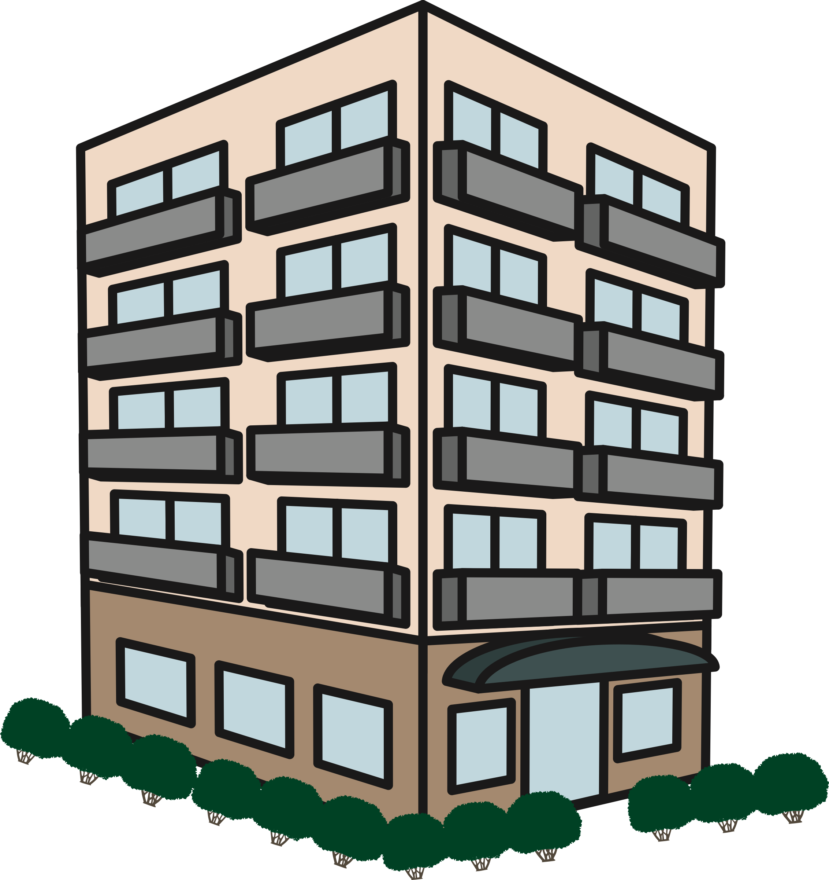

Comparing Virtual Machines and Containers
Virtual Machines ≈ Houses
Containers ≈ Apartments
If all you need is an apartment,
why buy a house?
Fully self-contained
Safeguarded from unwanted guests
Dedicated utilities
Dedicated rooms – kitchen, dining room, family room, living room, etc.
Isolated living spaces
Safeguarded from unwanted guests
Shared utilities
Shared rooms – kitchen/dining room, family/living room etc.)
Notes:
I want to share an analogy that helped me, for the first time, understand what containers actually are.
First, think of a virtual machine like a house
Everything you need, and probably some things you don’t need, come within a dedicated building on your own property.
You have:
Dedicated doors and locks to secure your house.
Dedicated power, water, natural gas, and Internet access.
And dedicated living spaces for specific purposes.
If you only ever use your kitchen, bathroom, and bedroom you have a lot of unused space which requires requires power, HVAC, window coverings…you get the idea.
Think of a container like an apartment
Instead of your own property, you live within your own dedicated space in a shared building.
You also have security by way of doors and locks.
The apartment complex provides shared access to utility services and every apartment has access to those services.
Some of the living spaces may have a shared purpose which means you can more efficiently use space.
There are plenty of reasons to have a house although it doesn’t make sense to buy a house if all you need is an apartment. Virtualization is great and absolutely necessary for many purposes. If, however, you need to run a simple service, say DNS or NTP, it may not make sense to install, secure, and maintain a full operating system, and its many included services which you don’t need for your purpose. This is where containers shine. Let’s compare the architectures of virtual machines and containers so you can see how this works.

Slide 8
Virtual Machine and Container Architecture
Type 1 Virtualization
Type 2 Virtualization
Containerization
Virtual Machines
Containers
App
App
App
App
App
App
Virtual Machines
App
App
App
Bin/Libs
Bin/Libs
Bin/Libs
Bin/Libs
Bin/Libs
Bin/Libs
Bin/Libs
Bin/Libs
Bin/Libs
OS
OS
OS
App
App
App
OS
OS
OS
Bin/Libs
Bin/Libs
Bin/Libs
Hypervisor (Type 2)
Docker Daemon
Docker Desktop Hypervisor (Type 2)
Hypervisor (Type 1)
Host OS
Host OS
Bare Metal
Bare Metal
Bare Metal
Notes:
There are two main types of virtualization:
Type I virtualization is what we see most often in IT operations.
On top of a bare metal server we install a hypervisor, like vSphere, for example.
On top of the hypervisor we can install a bunch of guest operating system instances.
And each of those operating systems has their own applications, binaries, and libraries.
We typically isolate applications to their own virtual machines to avoid resource conflicts.
Type II virtualization is largely the same with the key difference being we install an operating system on the bare metal and run the hypervisor as an application on the host OS.
Examples of type II hypervisors are things like VMware Fusion, KVM, and VirtualBox.
Virtual machines run in the same manner on a type II hypervisor as they do on a type I hypervisor.
In a containerized architecture we typically:
Install an operating system on bare metal and install a containerization platform on the operating system, in our case, that’s Docker.
Containers each have their own isolated copies of binaries and libraries to support applications although containers rely on the host OS for core or kernel services.
Not having to install a new operating system each time there is a need for a new service or feature gives containers a huge scale advantage over virtual machines.
Also, containers don’t boot up and shut down like virtual machines do.
Since the host OS provides kernel services to the container manager, containers can instantiate, start, stop, and restart in milliseconds.
That new DNS or NTP service you want to launch? Fire up a Docker Container and have access to the service instantly instead of waiting on an operating system to install or clone.
Now you need two DNS servers for redundancy? Launch a new Docker Container and you have another service in the blink of an eye.
If your container crashes, it can be back online faster before you realized it crashed.
One more thing to note, Docker relies on many Linux libraries and, therefore, it only runs on Linux.
If you’re thinking, “What about the Docker Desktop that you told me to install on my Mac or Windows computer?”
Docker Desktop runs both the Docker container platform and its own type II hypervisor which boots a Linux OS to run the Docker Daemon.
Anyway, containers don’t replace the need for virtual machines but they definitely show their strengths in many use cases. Let’s talk about some common situations that are great fits for containers but not so great for virtual machines.

Slide 9
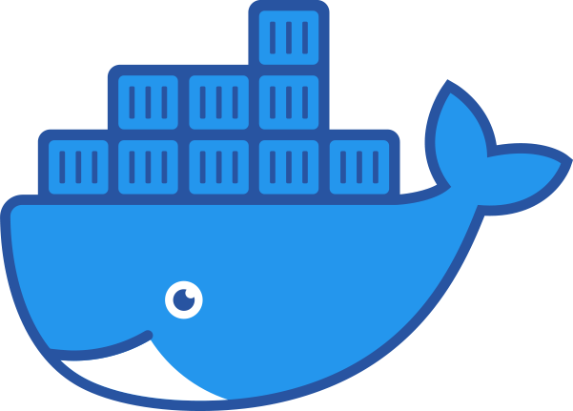



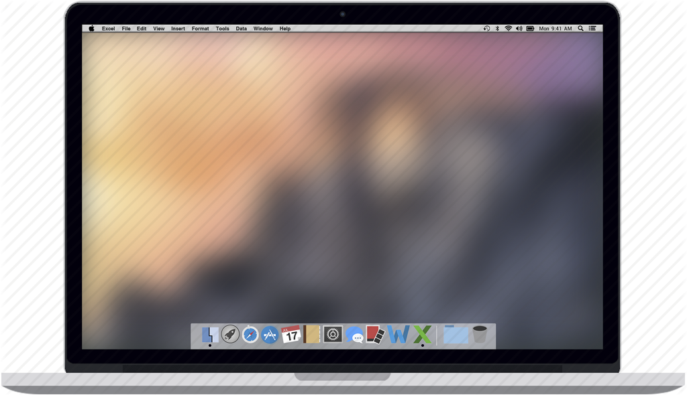


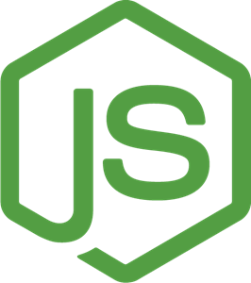
Wins for Docker
Standardized developer environments
Distributed, especially multi-cloud, environments
Micro-services architectures
Cross-OS tool usage
Service C
Service C
for x in range(3):
print(x)
Service B
Service B
Service A
Service A
Notes:
One of the first big wins for Docker is with standardized developer environments
Imagine someone shares a really sweet script or program with you and you try to run it on your computer only to experience the joy of some dependency error
You ask the person that built the script for help and they give you a very insightful reply like, “I don’t know what the problem is because it works just fine on my computer.”
Now I’m not a developer myself so I called my brother that works at a developer for a cloud-native software company that doesn’t use Docker containers for their development environments and asked him if he ever runs into situations where one persons code doesn’t work on someone else’s computer or in a different deployment environment.
His response, and I’ll only change the wording slightly was, “Dude, that sh&t happens 75 times a day; that’s the definition standard development environment around here.”
Someone could certainly build a virtual machine with all of the appropriate tools but distributing and maintaining who knows how many copies of a several-dozen gigabyte virtual machine isn’t going to work. There are too many moving parts, no good way to manage distribution and maintain version control, plus INFOSEC will go nuts when they can’t keep track of an unknown number of virtual machines to patch.
No imagine this scenario instead; the organization maintains a Docker Image that’s only a couple hundred megabytes in a version-controlled repository with all of their standardized development tools, packages, dependencies, and everything else they need to write code.
Anyone that wants to write code downloads the latest copy of the Docker Image, writes their code and it works on every developer's computer and in every runtime environment.
Nobody has to keep tight control of their package version inventory; they start up a Docker Container with all of the correct tools, every time.
The next win for Docker is with distributed, multi-cloud application deployments.
Let’s say, for example, an organization has an application running in AWS and they want to be able to move or expand it to Azure or even to their private cloud environment in a CoLo whenever there is high demand.
This is tough to orchestrate with virtual machines both because they tend to be big and require conversion when they move from platform to platform.
That’s too bulky and slow for most organizations that need to react on-demand.
By contrast Docker containers are small and highly portable because they have a standard format that will work in any environment.
Containerized applications are, generally, small and lightweight compared to their virtual machine counterparts.
Container orchestration platforms can quickly move services between clouds in a way that is transparent to the applications.
Another win for Docker is with micro-service-based application architecture
Many applications use a monolithic architecture, where multiple services run on the same server.
For example, a front-end web server may handle the delivery of e-commerce, product recommendation, and search services.
If that web server fails, all of those services become unavailable.
However, an application that uses a micro-services architecture, where each independent service runs in a separate Docker container, can tolerate the failure of a single service and still run, even if in a temporarily degraded state.
Maybe the product recommendations don’t work but shoppers can still search for products and place orders.
Micro-services also scale really, really well and a container orchestration platform can both maintain a minimum number of copies for any given service and automatically redeploy, within seconds, containers that fail.
The last win for Docker we will review is a bit simpler but really handy.
Let’s say you need a way to practice Bash commands for, say, an upcoming exam or you want to practice working with iptables.
There are a lot of reasons you might want or need to use a Linux tool on a Mac or Windows PC.
It may take you a few hours to get a Linux virtual machine running on your computer but you can install Docker Desktop and, with an Internet connection and a single command, have a functional copy of Linux online in less than a minute.
You can also run dozens of containers on your computer with a negligible impact to your system resources and create and destroy containers, just about instantly.
Docker really rocks when it comes to this sort of scale and speed.
There are many other wins for Docker, especially when it comes to automated testing. More on that later in the presentation.
So how does Docker actually work? Let’s take a look at the components that make up Docker.

Slide 10
Docker Engine Overview
Client
containers
docker CLI
networks
manages
REST API
manages
Server
images
data volumes
docker daemon
Notes:
The Docker Engine describe the pieces that make Docker what it is and there are three parts:
The Server, also known as the Docker Daemon is the process that is responsible for all of the stuff that Docker actually does.
For example, when you tell Docker to create a container, the Docker Daemon is responsible to carry out that instruction.
All instructions to the Docker Daemon must go through the second piece of the Docker engine, which is the REST API.
Its only job is to allow clients to communicate instructions to the Daemon.
That brings us to the last piece of the Docker Engine, the Docker Client.
A Docker Client can be any system that communicates with the Docker REST API although we typically think of the Docker Client as the Docker CLI.
The Docker CLI is the default client installed with docker and it provides a way to interact with the Docker Daemon, via the REST API.
The Docker CLI manages containers, images, networks, and data volumes and we will use the Docker CLI extensively in the hands-on exercises.
Unlike the Docker Daemon, the Docker Client installs on just about any operating system so you can manage remote instances of Docker whether or not you have the full Docker Engine on your computer.
This diagram is an exact copy of what you will find in the official Docker Documentation and I want to point that out because I think it’s important to know that I didn’t simplify the architecture for someone who new to Docker. All I did was adapt the diagram to build in PowerPoint; that’s all there is to Docker.
Let’s look at an example of how the components of the Docker Engine work together.

Slide 11
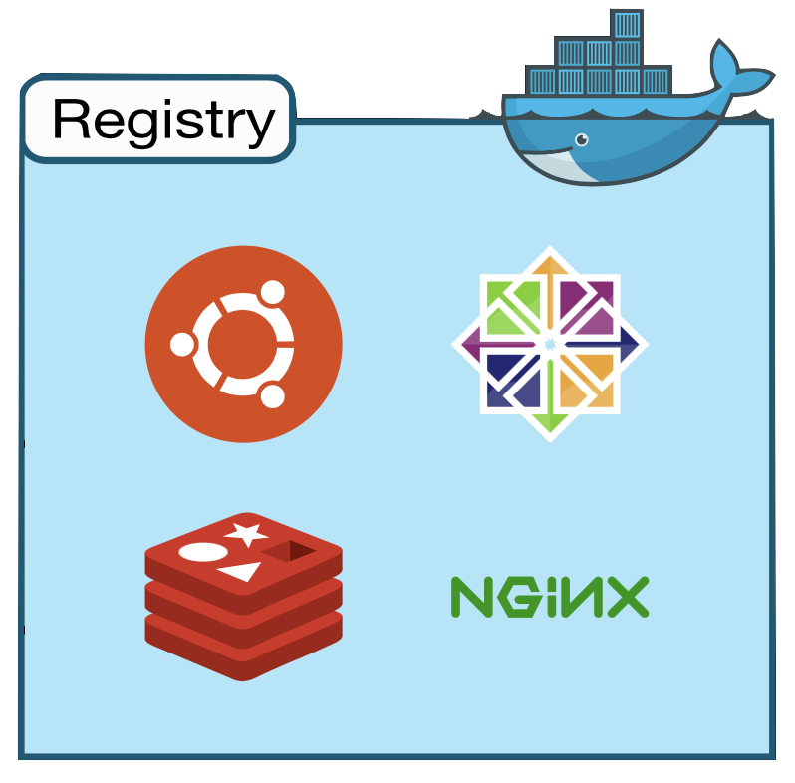
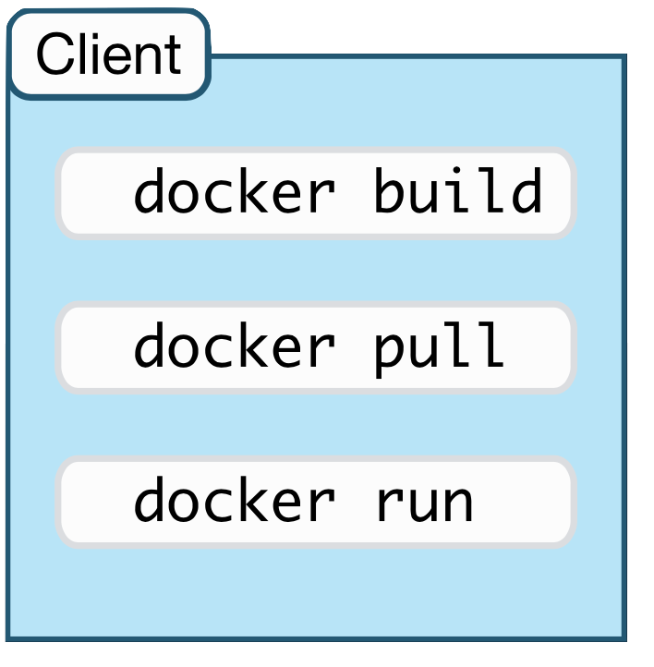
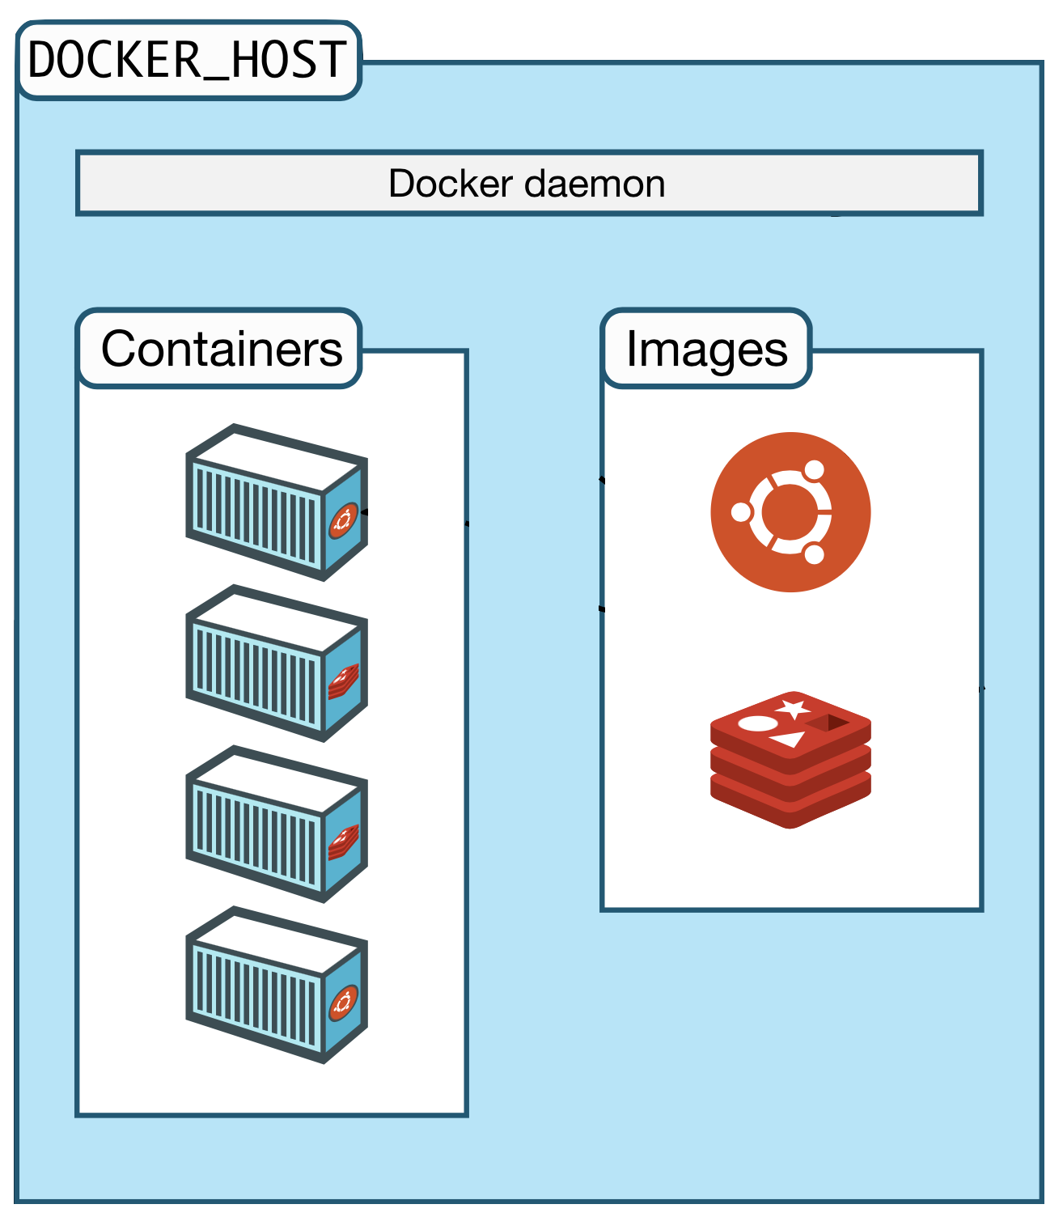
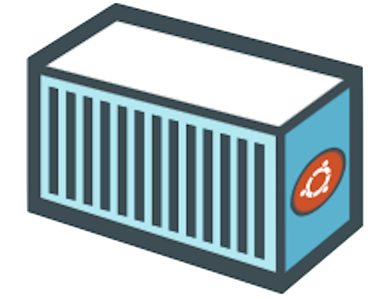

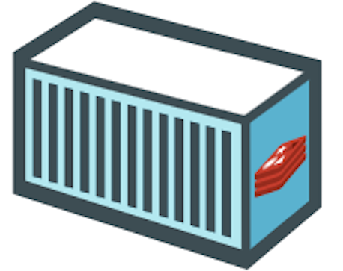
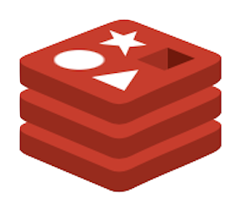
The Docker Architecture
Notes:
Here’s a simple example of how Docker works in in a real environment and it is an exact representation of what you will see and do in the hands-on exercises.
First, we have our Docker Client with some examples of the commands we will use in the hands-on exercises
Next, we have Docker Host which runs the Docker Daemon.
For our hands-on exercises, our computers are our own Docker Hosts and Docker Desktop provides the complete Docker Engine for us.
The Docker host has repositories for both Containers and Images and we will talk about the differences between those two things later on.
For now, there is an image for Ubuntu server already in our Image repository.
We send CLI commands to the Docker Daemon, via the REST API, we tell Docker what we want it to do.
In this case, we tell Docker to create two Ubuntu Containers and the Daemon does just that.
It’s common to not have the image we need in our local repository but we don’t need to scour the Internet to look for most Images…for this situation, we have Registries.
Let’s say we want to deploy two Containers with the official Redis database image.
We don’t have that image in our repository yet but Docker we can just tell Docker to deploy the Containers anyway.
Docker will try to find Images locally first and will automatically search the Docker Hub Registry if it doesn’t find the Image we asked for.
You can tell Docker to search other Registries too but, for our learning, we will stick to using the Docker Hub Registry.
A quick note about Docker Hub is that it hosts many official and unofficial Images.
Generally, official images come from OEMs and unofficial images come from people like us.
You can think of Docker Hub like a GitHub for Docker Images.
Anyway, Docker will download the Redis Image from Docker Hub and then create the Containers we asked for.
Now that the Redis Image is in our local repository, any new Redis Containers we deploy will pop up just about instantly.
In the interest of simplicity and transparency, this is another diagram that I pulled straight from Docker’s documentation and adapted for PowerPoint. While there is much more that we can do with Docker, this is a good representation of how the basics work.

Slide 12
Part II
Verify Your Docker Installation
Notes:
// TODO

Slide 13
Sign In to Docker Desktop
Open/start Docker Desktop
Log on with your Docker Hub account
krismiller
Notes:
// TODO

Slide 14
Verify Your Docker Installation
Open your preferred terminal (bash, PowerShell, zsh, etc.)
Enter the commands:
docker --version
docker info
docker run hello-world
Notes:
// TODO

Slide 15
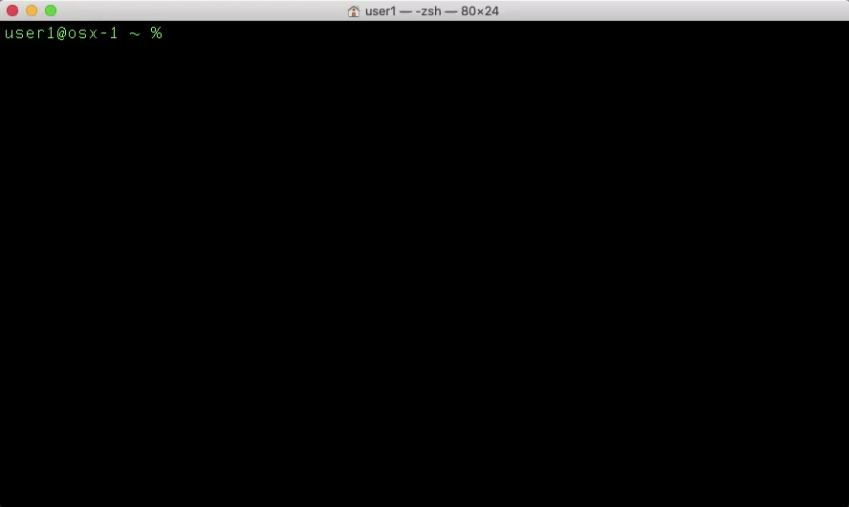
Release Year
Release Month
Notes:
// TODO

Slide 16
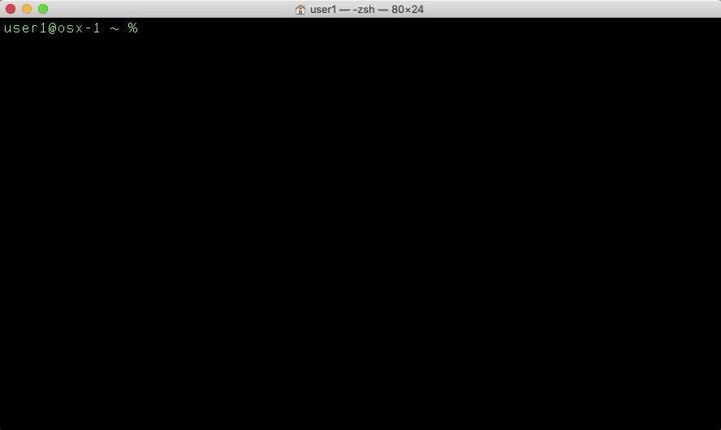
Notes:
// TODO

Slide 17
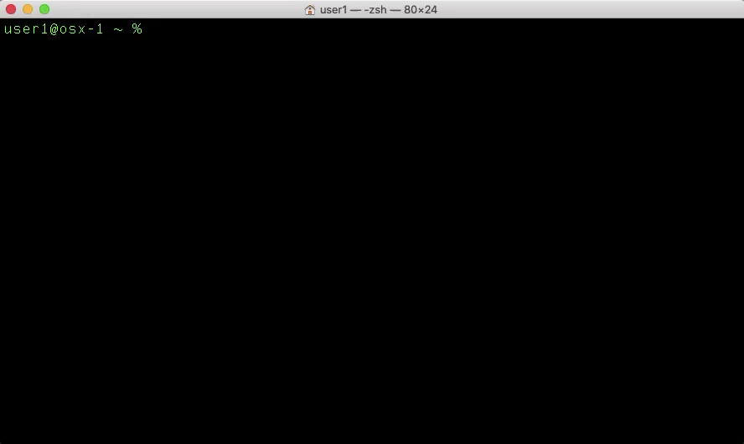
Notes:
// TODO

Slide 18
Part III
Create a Docker Image
Notes:
// TODO

Slide 19
Docker Images
Immutable templates for Docker Containers
Built using a Dockerfile with all required binaries, packages, etc.
List your Docker Images with the terminal command:
docker image ls
Notes:
// TODO

Slide 20
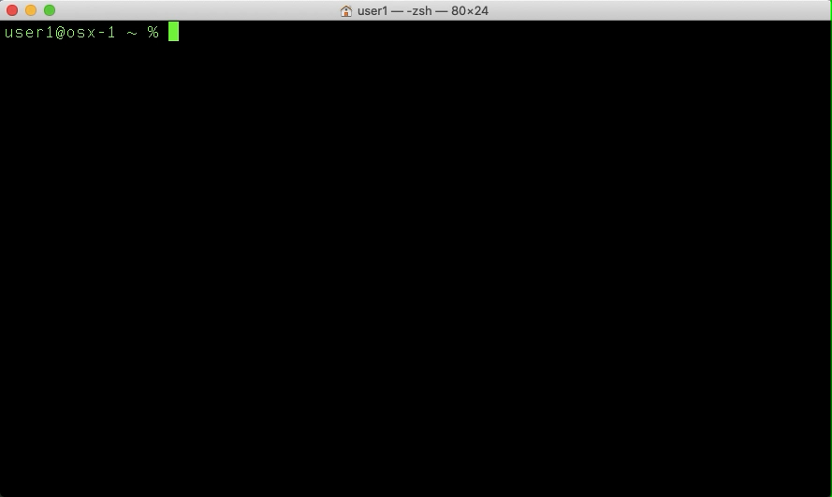
Notes:
// TODO

Slide 21
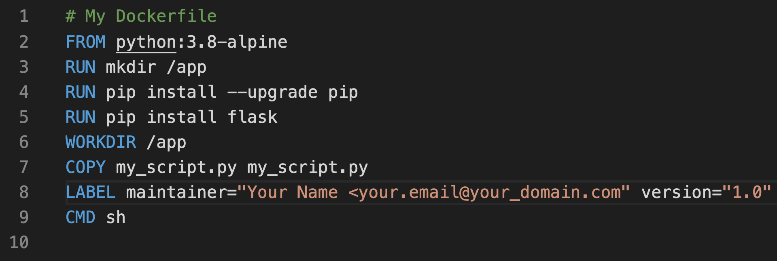
The Dockerfile
The Docker Image blueprint, read from top to bottom
A text file named “Dockerfile”
Comprised of UPPERCASE instructions
Each instruction represents a layer of the image
Notes:
// TODO

Slide 22


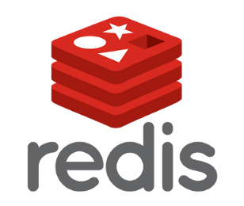
The Dockerfile
Dockerfile
FROM python:3.8-alpine
RUN pip install flask
RUN apk add redis
CMD sh
Notes:
// TODO

Slide 23
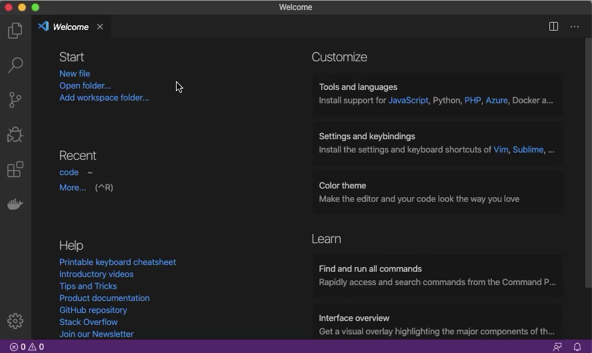
Notes:
// TODO

Slide 24
The FROM Instruction
Always the first instruction, specifies base OS image
Base image index available on https://hub.docker.com
Formatted using tags
FROM python:3.8-alpine
FROM instruction
Alpine Linux OS
Python official image
Python version 3.8
https://hub.docker.com/_/python
Notes:
// TODO

Slide 25
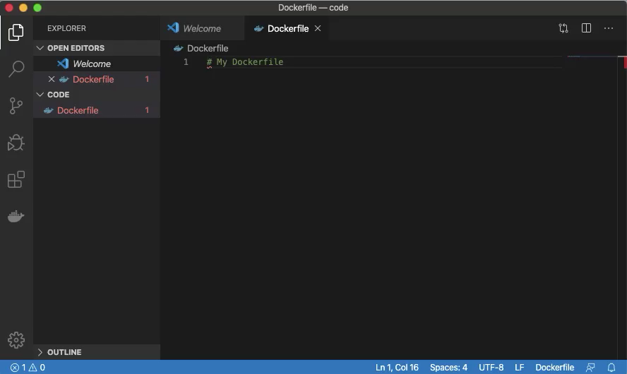
Notes:
// TODO

Slide 26
The RUN Instruction
Runs any command/script available in the OS
Create directories (mkdir), install packages (pip, apk, yum, etc.), run scripts, etc.
RUN mkdir /app
RUN instruction
Shell command
RUN pip install --upgrade pip
RUN pip install flask
RUN apk add redis
Notes:
// TODO

Slide 27
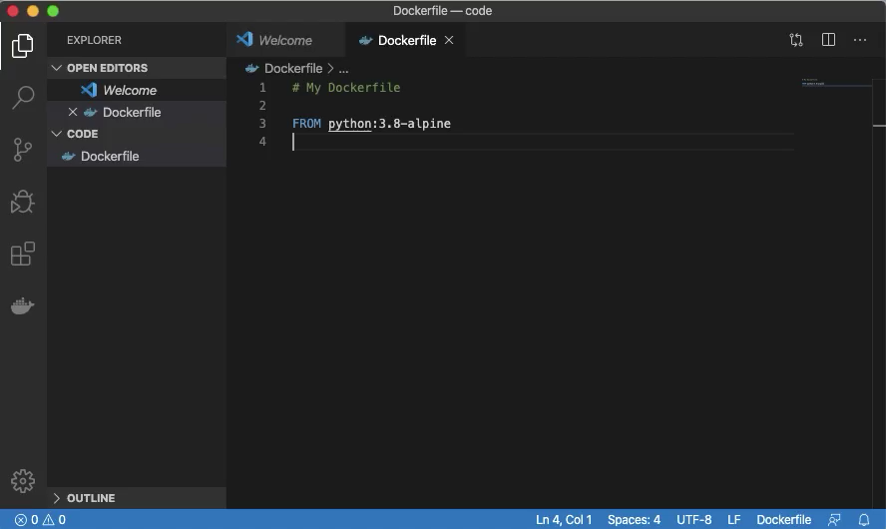
Notes:
// TODO

Slide 28
The WORKDIR Instruction
Sets the working directory for other instructions (RUN, COPY, etc.)
Accepts absolute or relative paths (/home/folder1, folder1)
Will be the result of the pwd command in the container
WORKDIR /app
WORKDIR instruction
Working directory
WORKDIR bin
WORKDIR resources
bash$
pwd
returns
/app/bin/resources
Notes:
// TODO

Slide 29
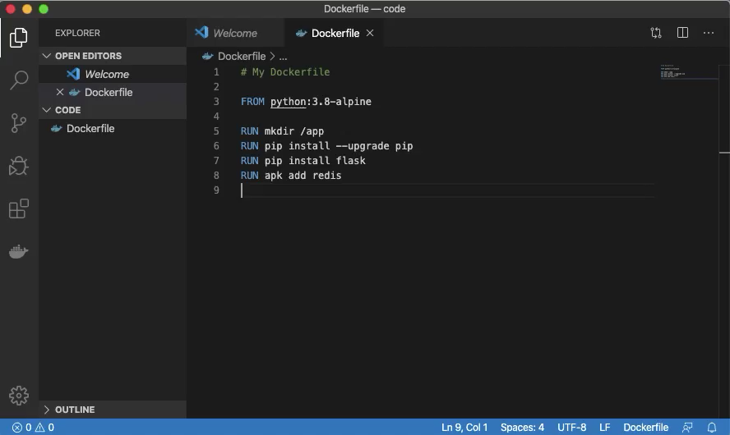
Notes:
// TODO

Slide 30
The COPY Instruction
Copies files or directories to the image
Accepts absolute or relative paths (/home/folder1, folder1)
Accepts wildcard characters (*.txt)
COPY my_script.py myscript.py
COPY instruction
source
destination
COPY files_dir /home/files_dir
COPY . .
Notes:
// TODO

Slide 31
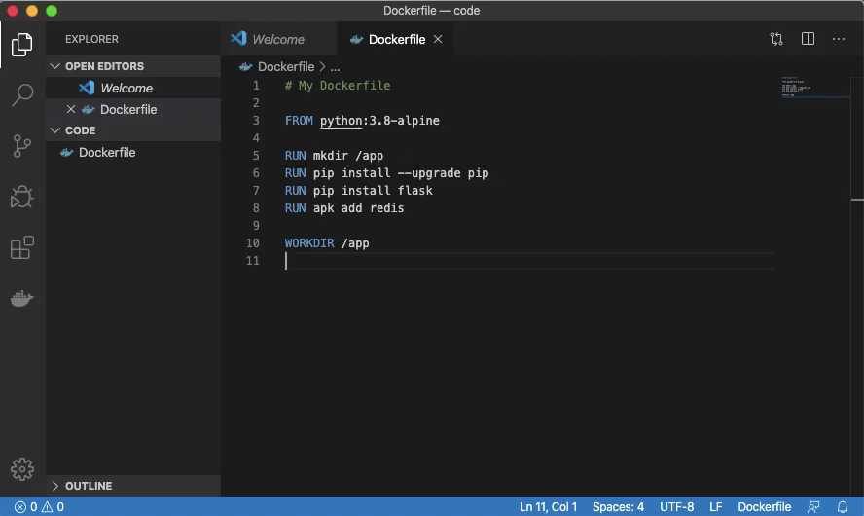
Notes:
// TODO

Slide 32
The EXPOSE Instruction
Informs Docker that the container listens on a specific port at runtime
Does NOT actually publish the port, functions as documentation
Info from the image builder to the person who runs the container
EXPOSE 8080
EXPOSE instruction
port (TCP is the default)
EXPOSE 8080/tcp
EXPOSE 8080/udp
Notes:
// TODO

Slide 33
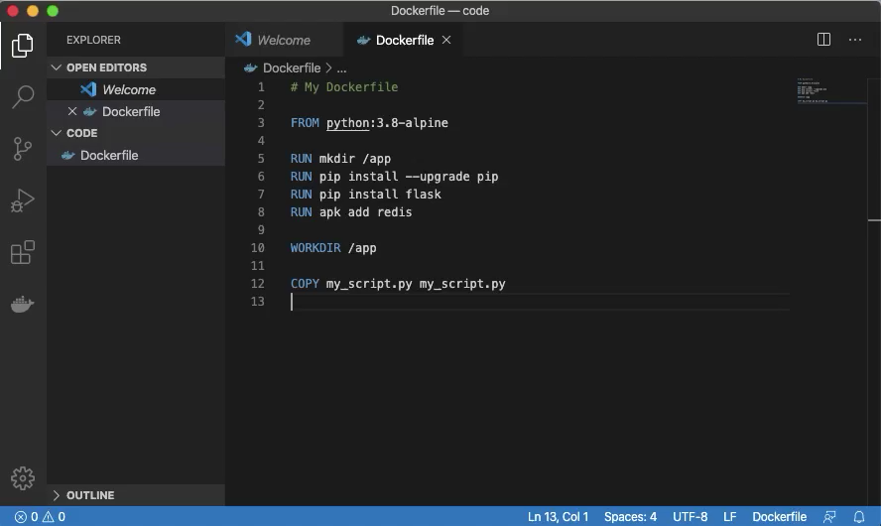
Notes:
// TODO

Slide 34
The LABEL Instruction
Adds metadata to the image
Denoted in key-value pairs (maintainer="Kris Miller")
Dockerfiles support single and multi-line LABEL instructions
LABEL maintainer="Kris Miller <kris.miller@acme.com>"
LABEL instruction
key
value
LABEL version="1.0"
LABEL description= "Web Application Image"
Notes:
// TODO

Slide 35
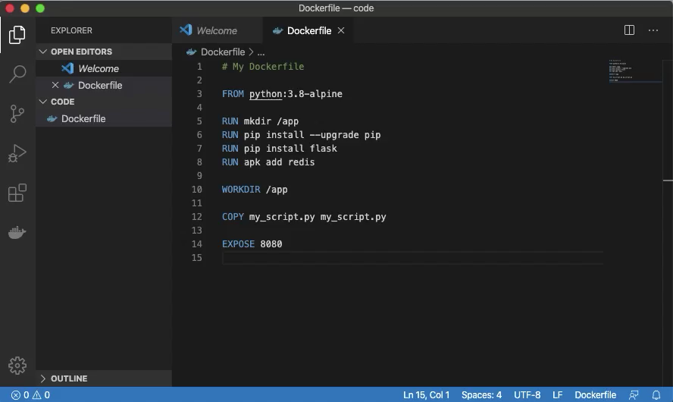
Notes:
// TODO

Slide 36
The CMD Instruction
Specifies the executable for containers run at startup (sh, flask, etc.)
The Final Dockerfile instruction
Only one CMD instruction allowed
CMD sh
CMD instruction
executable
CMD echo "Hello World"
CMD flask run --host=0.0.0.0 --port=5000
Notes:
// TODO

Slide 37
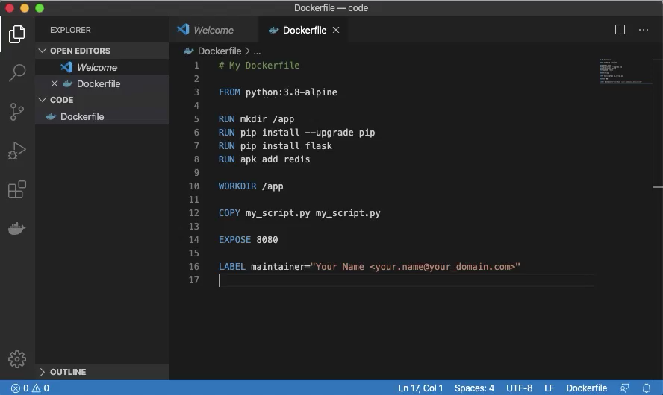
Notes:
// TODO

Slide 38
Build Docker Images
You have a complete Dockerfile, let’s do something with it!
Open your terminal and switch to the directory with your Dockerfile
For example, cd ~/code
Create a Docker Image with either of these commands:
docker build -t my_image .
docker image build -t my_image .
Don’t forget the dot!
Notes:
// TODO

Slide 39
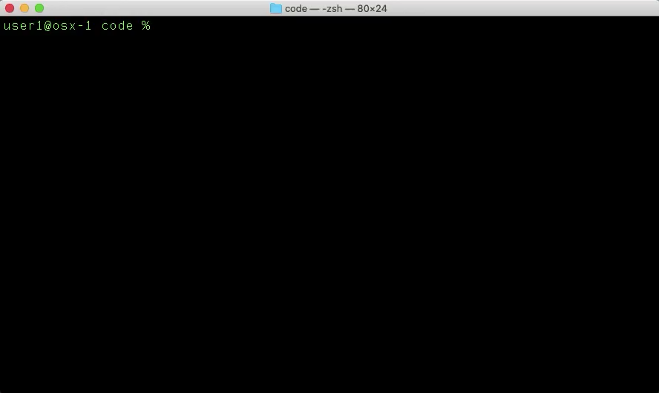
Notes:
// TODO

Slide 40
Remove Docker Images
List your Docker Images with the terminal command:
docker image ls
Remove your Docker Image with either of these commands:
docker image rm my_image
docker image rm image_id (docker image rm 6d37630d7e9b)
In some cases, you need to use the -f option to force removal:
docker image rm -f my_image
List your Docker Images again to confirm the delete:
docker image ls
Notes:
// TODO

Slide 41

Notes:
// TODO

Slide 42
Docker Image Challenge
Rebuild your Docker Image
What is different between the first and second builds?
Notes:
// TODO

Slide 43

Notes:
// TODO

Slide 44
Part IV
Run Docker Containers
Notes:
// TODO

Slide 45
Docker Containers
Ephemeral instances of Docker Images
List your Docker Containers with the terminal command:
docker container ls -a
Notes:
// TODO

Slide 46
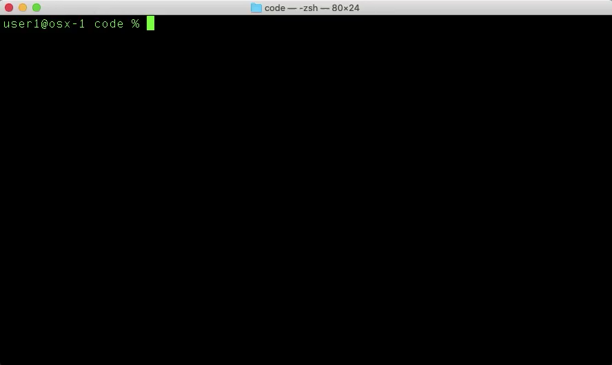
Notes:
// TODO

Slide 47
Docker Container Command Flags
Several command flags are necessary to run a Docker Container
docker container run [FLAGS] image_name
-i – interactive mode
-t – create a pseudo-TTY session
--name my_container – assign a name to the container
-v host_dir:container_dir – mount a volume to the container
-p host_port:container_port – publish a container port to the host
-d – run the container in the background (detached mode)
--rm – automatically remove the container on exit
image_name – specify the source image name for the container
Notes:
// TODO

Slide 48
Docker Container Command Examples
docker container run -it --name my_cont my_image
Create a Container named my_cont from the my_image Image
Use interactive mode with a pseudo-TTY session
docker container run -itv /code:/app --name my_cont my_image
Mount the local folder /code the container folder /app
docker container run -dp 8443:443 --name --rm my_cont my_image
Run the Container in background (detached) mode
Forward the local (host) TCP port 8443 to the container TCP port 443
Remove the container when it stops
Notes:
// TODO

Slide 49
Create a Docker Container
Use your Docker Image to create a Docker Container
docker container run -it --name my_cont my_image
Exit interactive terminal mode with the escape key sequence
control + p + q
List your Docker Containers
docker container ls -a
Notes:
// TODO

Slide 50
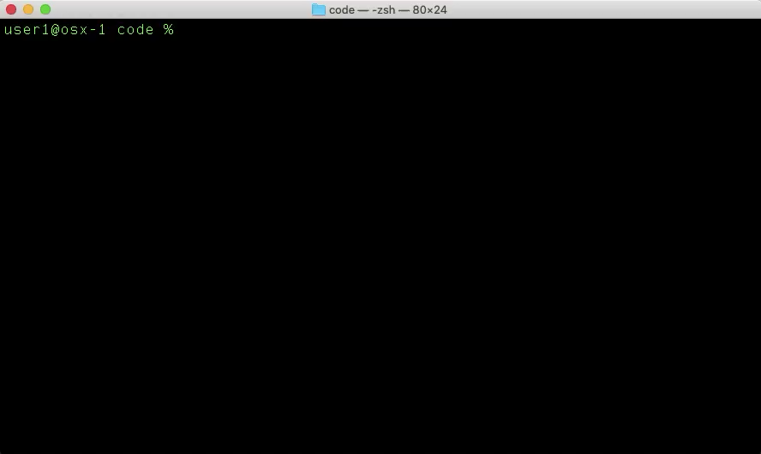
Notes:
// TODO

Slide 51
Attach to a Running Container
List your Docker Containers
docker container ls -a
Attach to your running container
docker container attach my_cont
Locate the Python script in your container
ls -l
Run the Python script in your container
python my_script.py
Notes:
// TODO

Slide 52

Notes:
// TODO

Slide 53
Stop a Running Container
List your Docker Containers
docker container ls -a
Stop your running container
docker container stop my_cont
List your Docker Containers again, to observe the new container state
docker container ls -a
Notes:
// TODO

Slide 54
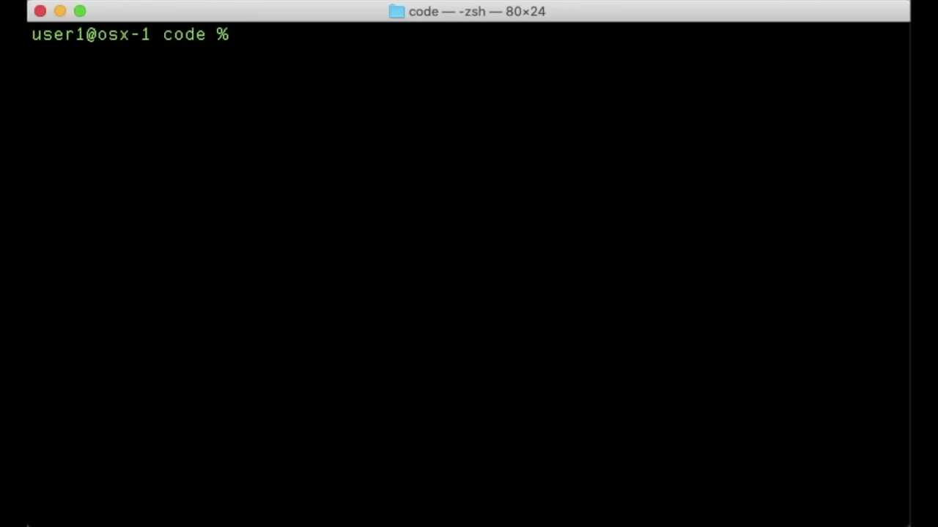
Notes:
// TODO

Slide 55
Start a Stopped Container
List your Docker Containers
docker container ls -a
Start your stopped container
docker container start my_cont
List your Docker Containers again, to observe the new container state
docker container ls -a
Notes:
// TODO

Slide 56

Notes:
// TODO

Slide 57
Remove a Container
List your Docker Containers
docker container ls -a
Stop your running container
docker container stop my_cont
Remove your stopped container
docker container rm my_cont
List your Docker Containers again, to see the result of the removal
docker container ls -a
Notes:
// TODO

Slide 58
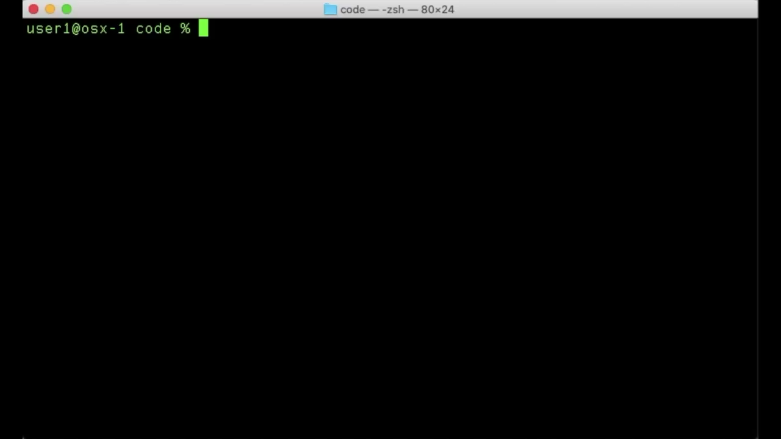
Notes:
// TODO

Slide 59
Create a Docker Container With a Mapped Volume
Create a new directory and file on your host computer
mkdir my_dir
cd my_dir
vi my_file
Press i to insert text, type some text, press escape
Type :x and press Enter/Return to save and exit
Use your Docker Image to create a Docker Container
docker container run -itv $PWD:/app/files --name my_cont my_image
Observe the mapped volume in your Container
ls -l
cd files
cat my_file
Notes:
// TODO

Slide 60

Notes:
// TODO

Slide 61
Part V
Docker Quick Hits
Notes:
// TODO

Slide 62
Docker Quick Hit Topics
Docker Exec
Docker Networks
Docker Compose
Cleaning Up
Notes:
// TODO

Slide 63
Docker Exec
Run Container shell commands from the Docker Host terminal
Allows interaction with Containers without first attaching
docker exec [FLAGS] container_name command
docker exec -it my_cont pwd
docker exec -it my_cont ls -la
docker exec -it my_cont sh -c "cat /etc/*-release"
docker exec -it my_cont python my_script.py
Notes:
// TODO

Slide 64
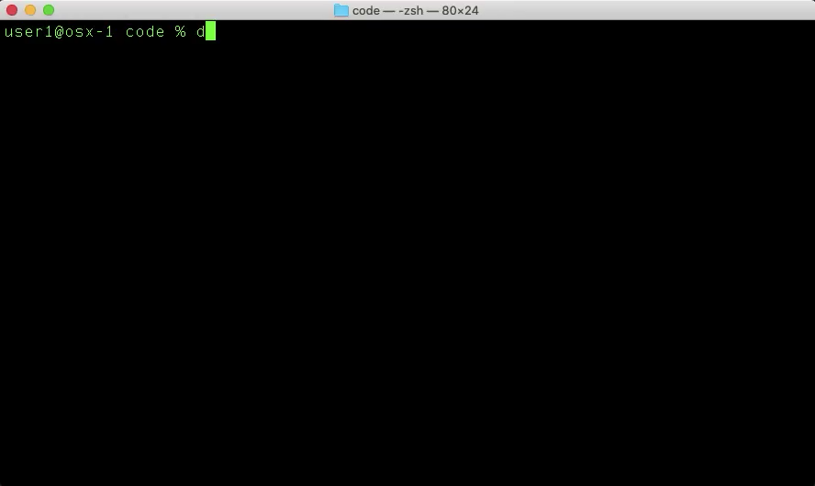
Notes:
// TODO

Slide 65
Docker Networks
Enable communication between multiple Docker Containers
Isolate Docker applications to their own networks
Use automatic DNS to simplify Container connectivity
Notes:
// TODO

Slide 66
Deploy a Docker Network
Create a Docker Network and connect two Containers
docker network list
docker network inspect bridge
docker network create --driver bridge my_net
docker network list
docker network inspect my_net
docker container run -itd --net my_net --name my_cont1 my_image
docker container run -itd --network my_net --name my_cont2 my_image
Notes:
// TODO

Slide 67
Deploy a Docker Network
Validate Docker Network connectivity
docker container ls -a
docker exec -it my_cont1 ifconfig eth0
docker exec -it my_cont2 ifconfig eth0
docker exec -it my_cont1 ping -c 4 my_cont2
docker exec -it my_cont2 ping -c 4 my_cont1
Notes:
// TODO

Slide 68

Notes:
// TODO

Slide 69
Docker Compose
Tool for building and running multi-container Docker applications
Simple orchestration tool for Docker with YAML instructions
Single command to build/deploy or destroy multi-container applications
Frequently used with CI/CD pipelines
Deploy pre-configured test environments
Run tests
Destroy test environments
Notes:
// TODO

Slide 70
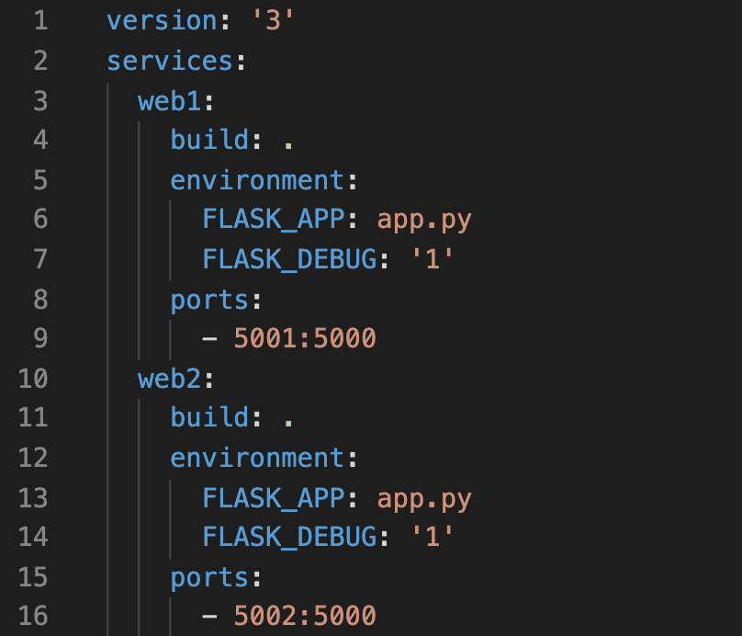
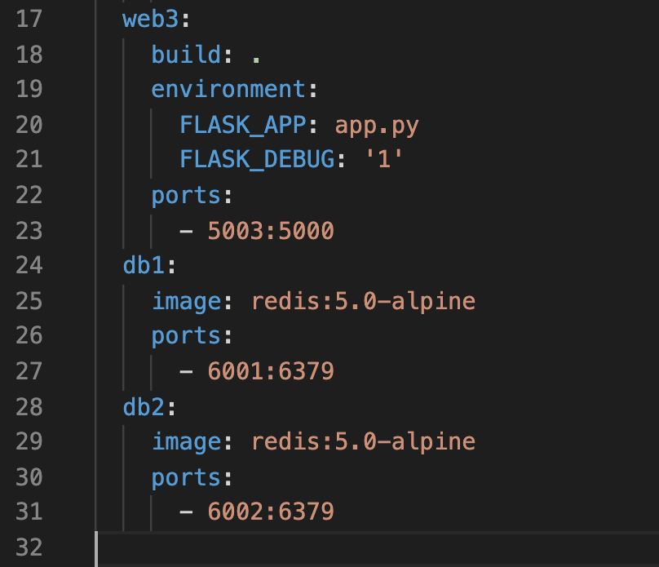
Example docker-compose.yml
Deploys 3 x web servers and 2 x database servers with one command
Notes:
// TODO

Slide 71
Docker Compose
Use Docker Compose to create/deploy and verify a five Container app
docker container ls -a
docker-compose up -d
docker container ls -a
curl http://localhost:5001
curl http://localhost:5002
curl http://localhost:5003
docker-compose down
docker container ls -a
Notes:
// TODO

Slide 72
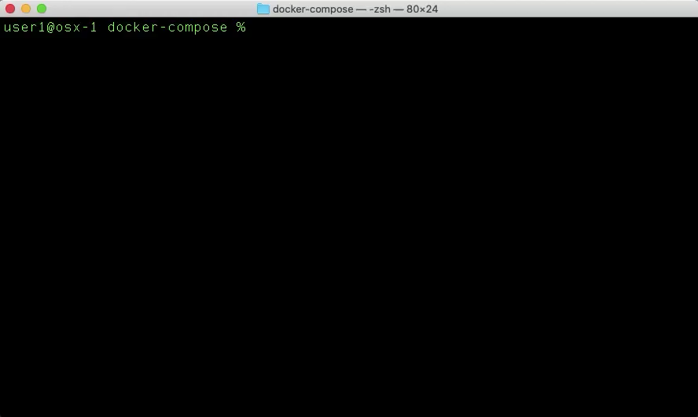
Notes:
// TODO

Slide 73
Cleaning Up
Notes:
// TODO

Slide 74
Understand Docker Disk Usage
How much storage do Images and Containers use?
docker system df
docker system df -v
Notes:
// TODO

Slide 75


Slide 76
Stop All Running Containers
What is an easy way to stop all running Containers?
docker container stop $(docker container ls -q)
Notes:
// TODO

Slide 77


Slide 78
Remove All Stopped Containers
What is an easy way to remove all stopped Containers?
docker container prune
Notes:
// TODO

Slide 80
Remove Dangling Images
Dangling Images are those with <none> Repository and Tag values
What is an easy way to remove dangling Images?
docker image prune
Notes:
// TODO

Slide 81


Slide 82
Docker System Cleanup
How to easily remove all:
Dangling Images
Stopped Containers
Unused Networks
Build cache
docker system prune
Remove all of the above plus all unused Volumes:
docker system prune --volumes
Notes:
// TODO

Slide 83


Slide 84
Remove Unused Images
Unused Images are those which have no associated Containers
What is an easy way to remove unused Images?
docker image prune -a
Notes:
// TODO

Slide 85


Slide 86
Part VI
Quiz & References
Notes:
// TODO

Slide 87

Docker Quiz
https://github.wwt.com/pages/hullt/devnet-quizzes/docker-fundamentals/

Slide 88
References
https://docs.docker.com/install
https://docs.docker.com/engine/docker-overview
https://docs.docker.com/engine/reference/builder
https://docs.docker.com/engine/reference/commandline
https://docs.docker.com/network/
https://docs.docker.com/compose
https://en.wikipedia.org/wiki/Docker_%28software%29
https://en.wikipedia.org/wiki/OS-level_virtualization
https://diveintodocker.com – paid instructional course

Slide 89
Notes:
// TODO

